Slide 1


WEEK 3
SPRINT 1
PL6
QUA

Slide 2


about us.

Slide 3
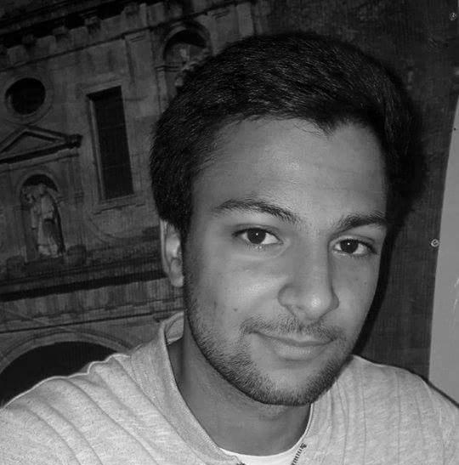
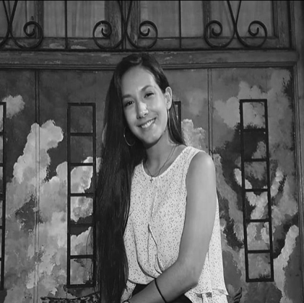

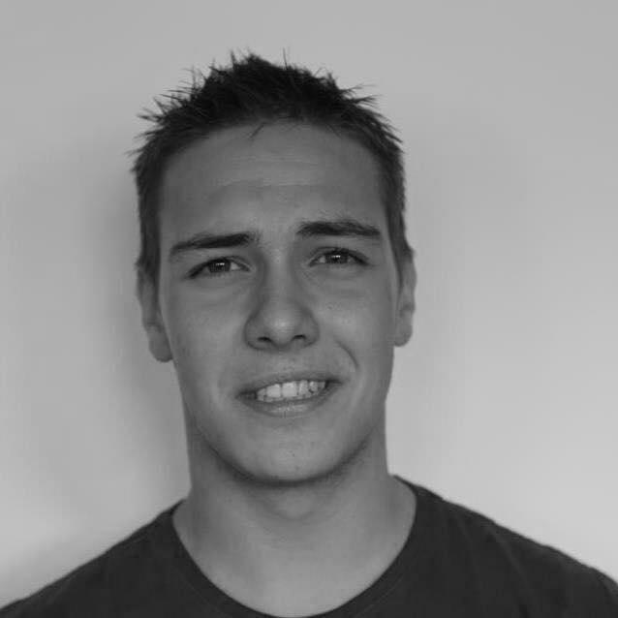
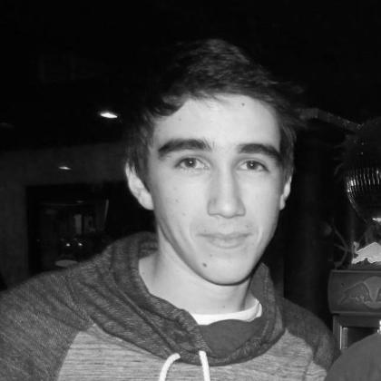
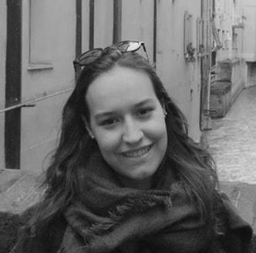
QUA
Hugo Marques
Viviana Abreu
Maria Alves
Luís Gonçalves
Rui Reis
Ana Almeida

Slide 4
tasks.
 | TASK #1 | TASK #2 | TASK #3 | TASK #4 | TASK #5
TASK | Task delegation and group leadership | Elaboration of the meeting minutes | Status data gathering from the other units | Weekly presentation | Organization of the tasks and presentation
OWNER | Hugo Marques | Maria Alves Rui Reis | Viviana Abreu Luís Gonçalves | Hugo Marques | Ana Almeida
GOAL EFFORT | 1 HOUR | 2 HOUR | 2 HOURS | 30 MINUTES | 2 HOURS
EFFECTIVE EFFORT | 1 HOUR | 2 HOURS | 1 HOURS | 30 MINUTES | 2 HOURS
STATUS | COMPLETED | COMPLETED | IN PROGRESS | COMPLETED | COMPLETED

Slide 5
planned tasks.
 | TASK #1 | TASK #2 | TASK #3 | TASK #4 | TASK #5 | TASK #6
TASK | Task delegation and group leadership | Elaboration of the meeting minutes | Status data gathering from the other units | Weekly presentation | Drafting of the Quality Manual | Organization of the tasks and presentation
OWNER | Hugo Marques | Maria Alves | Viviana Abreu | Hugo Marques | Luís Gonçalves Rui Reis Ana Almeida Viviana Abreu | Ana Almeida
GOAL EFFORT | 2 HOURS | 2 HOURS | 2 HOURS | 30 MINUTES | 4 HOURS (each) | 2 HOURS
STATUS | IN PROGRESS | IN PROGRESS | IN PROGRESS | IN PROGRESS | IN PROGRESS | IN PROGRESS

Slide 6
additional notes.
Regarding the group work on the previous week, we can say that we communicated well within the unit and that we were readily available to work with the rest of team. When it came to weekly goals and tasks, we mostly succeeded, completing almost everything that we had set out to do, with the deadlines and well distributed unit tasks. On the other side, when it came to hardships, we had trouble matching our different schedules and finding time to have meetings.

